Slide 1
Comparing Word2vec, Doc2Vec model driven Sentiment Analysis using SVM, LR vs Keras CNN and Bidirectional LSTM with and without pre-trained Word and Document Embeddings
Sofia Dutta
Data 602 – Spring 2019
Semester Project
Notes:
Good evening folks, today I am going to present my semester project for Data 602 – Introduction to Data Analysis and Machine Learning
In this project I am going to carry out Sentiment analysis using both the machine learning library Keras and common classification algorithms like SVM that use Word2Vec embeddings as their features.
I will compare the results of these two and present the results in my final report.

Slide 2
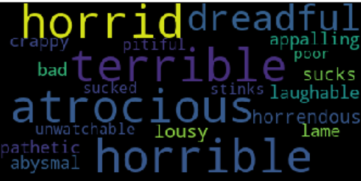
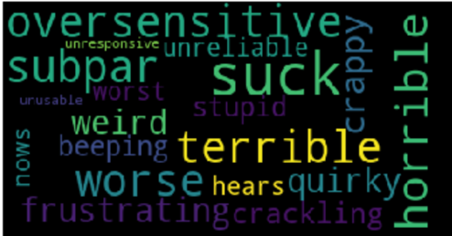
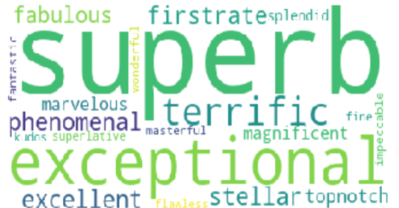
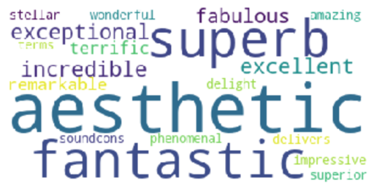
Introduction Sentiment Analysis

Slide 3
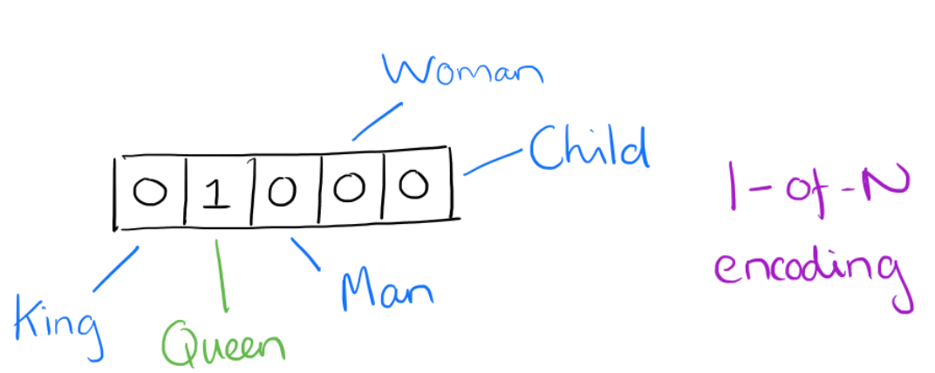
What is a word vector?
Assume a vocabulary has five words: King, Queen, Man, Woman, Child.
One-hot vector doesn’t allow meaningful comparisons, i.e. no semantics available
The solution is to use Word2Vec which uses distributed representation of word in vector space.
One-hot encoded vector for ‘Queen’
Notes:
Let’s assume a vocabulary has five words: King, Queen, Man, Woman, Child. A one-hot encoded vector of a word in this language will have 1 in a single position to represent a specific word. All other elements will be zero. Such an encoding can only allow comparisons in form of equality testing. Meaningful comparisons cannot be performed as each word is independent of each other. Word2Vec on the other hand represents words using a distributed representation. Each word represented by a vector is defined by the combination of its various aspects. Aspects are represented in the elements of the vector. As a result, we can have an aspect of royalty, gender, age etc. in our “little language”. Once such a representation is created, we can perform algebraic operations with language. We can remove the masculinity of a King by performing vector(“King”) – vector(“Man”). Then we can add femininity to the result vector by adding vector(“Woman”) to it to obtain a vector that is closest to the vector representation of the word Queen. See image below

Slide 4
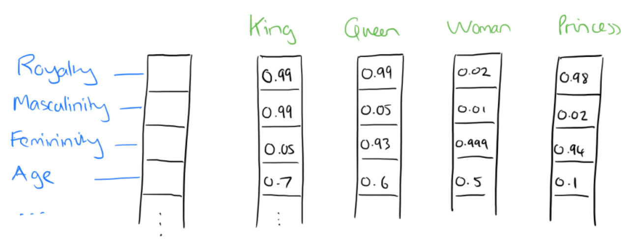
What is a word vector?
Distributed representations of word2vec can help encode various aspects of a word
Aspects are represented by elements of the vector and can help define a word
Aspects can represent things like royalty, gender or age in our “little language”

Slide 5
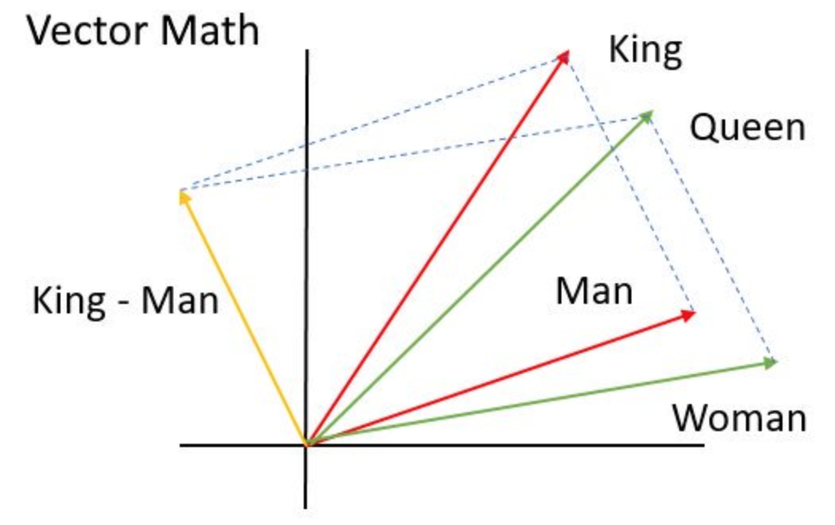
What is a word vector?
It has been observed that we can perform simple algebraic operations on the word vectors.
We can remove the masculinity aspect from King by performing the vector operation: vector(“King”) – vector(“Man”)
Following that we can add vector(“Woman”) to the result from above and obtain a vector that will be closest to the vector representation of the word Queen.

Slide 6
System architecture

Slide 7
Movie review dataset
50K reviews
Amazon Laptop review dataset
40K+ reviews
Cleanup and
pre-processing
Word and Document embeddings
Logistic regression, XGBoost, SVM etc.
Keras word embeddings
Keras CNN, Keras Bidirectional LSTM
Notes:
The source for movie review dataset is from Stanford https://ai.stanford.edu/~amaas/data/sentiment/aclImdb_v1.tar.gz
And the source URL for the Amazon product review is from UIUC http://sifaka.cs.uiuc.edu/~wang296/Data/LARA/Amazon/AmazonReviews.zip
There is no cost to accessing this data. Accessing this data does not require creation of an account. Accessing this data does not violate any laws.
The Data Set I am using is amazon laptops review and movie review.
IMDb shape: Before Shape of the Data Frame : (50000, 2) After Shape of the Data Frame : (50000, 2)
Amazon shape: Before Shape of the Data Frame : (40762, 2) After Shape of the Data Frame : (40762, 2)
Performing sentiment analysis. Using Word2Vec word embeddings Classification Algorithms: Logistic regression, XGBoost, SVM, Random Forest
Compared results to Keras Convolutional Neural Network

Slide 8
Data overview
Data source | Columns | Dataset review count |  |  | Max review length |  | Comments
 |  | Total | Positive | Negative | Positive | Negative
Amazon laptop reviews | Review Rating | 40K+ | ~30K | ~10K | 20K | 3K | Distribution mass should be covered by 900 to 1000 characters
IMDb movie reviews | Review Rating | 50K | 25K | 25K | 14K | 5K | Distribution mass should be covered by 1400 to 1500 characters
Notes:
The first dataset of laptop product reviews from Amazon’s website contained 40,744 reviews. The dataset contained over 30K positive reviews and close to 10K negative reviews. The longest positive review length contained over 20,000 characters and longest negative review contained close to 3,000 characters. The box plot of review length shows exponential properties. Looking at the graph shown in Fig 5 it can be estimated that the mass of the distribution can probably be covered with a clipped length of 900 to 1,000 words. The review dataset contains just two columns, one with the rating and the other with the review text.
The IMDb movie review dataset contains 50,000 reviews. The dataset contains equal number of reviews annotated as positive and negative. The longest positive review length contains about 14,000 characters and the longest negative review contains close to 5,000 characters. Similar to the first dataset, the box plot of review length shows exponential properties. Looking at the graph shown in Fig 6 it can be estimated that the mass of the distribution can probably be covered with a clipped length of 1,400 to 1,500 words. The review dataset contains just two columns, one with the rating and the other with the review text.

Slide 9
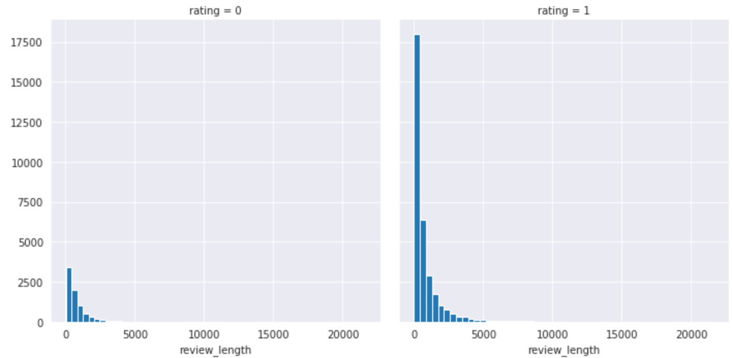
Data exploration: Review Length, Laptop reviews
Laptop dataset review lengths
Notes:
The first dataset of laptop product reviews from Amazon’s website contained 40,744 reviews. The dataset contained over 30K positive reviews and close to 10K negative reviews. The longest positive review length contained over 20,000 characters and longest negative review contained close to 3,000 characters. The box plot of review length shows exponential properties. Looking at the graph shown in Fig 5 it can be estimated that the mass of the distribution can probably be covered with a clipped length of 900 to 1,000 words. The review dataset contains just two columns, one with the rating and the other with the review text.
The IMDb movie review dataset contains 50,000 reviews. The dataset contains equal number of reviews annotated as positive and negative. The longest positive review length contains about 14,000 characters and the longest negative review contains close to 5,000 characters. Similar to the first dataset, the box plot of review length shows exponential properties. Looking at the graph shown in Fig 6 it can be estimated that the mass of the distribution can probably be covered with a clipped length of 1,400 to 1,500 words. The review dataset contains just two columns, one with the rating and the other with the review text.

Slide 10
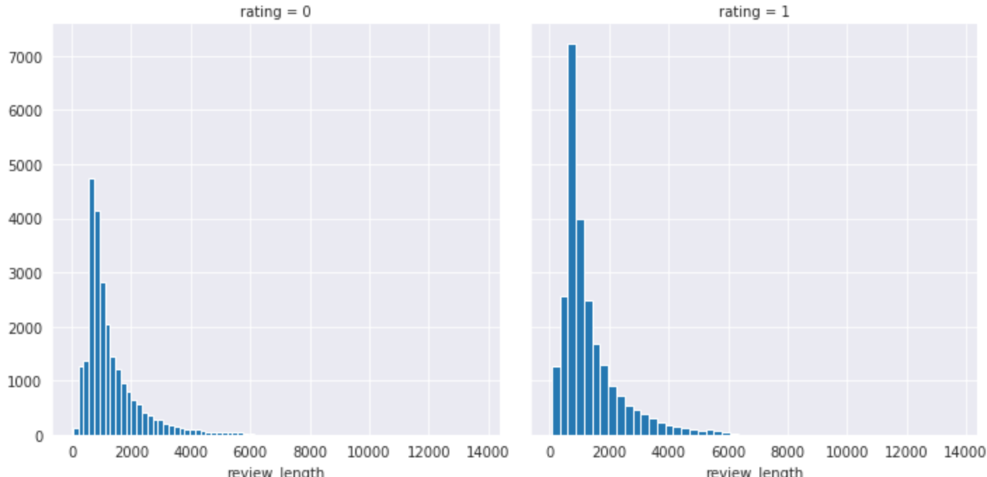
Data exploration: Review Length, Movie reviews
Movie dataset review lengths
Notes:
The first dataset of laptop product reviews from Amazon’s website contained 40,744 reviews. The dataset contained over 30K positive reviews and close to 10K negative reviews. The longest positive review length contained over 20,000 characters and longest negative review contained close to 3,000 characters. The box plot of review length shows exponential properties. Looking at the graph shown in Fig 5 it can be estimated that the mass of the distribution can probably be covered with a clipped length of 900 to 1,000 words. The review dataset contains just two columns, one with the rating and the other with the review text.
The IMDb movie review dataset contains 50,000 reviews. The dataset contains equal number of reviews annotated as positive and negative. The longest positive review length contains about 14,000 characters and the longest negative review contains close to 5,000 characters. Similar to the first dataset, the box plot of review length shows exponential properties. Looking at the graph shown in Fig 6 it can be estimated that the mass of the distribution can probably be covered with a clipped length of 1,400 to 1,500 words. The review dataset contains just two columns, one with the rating and the other with the review text.

Slide 11
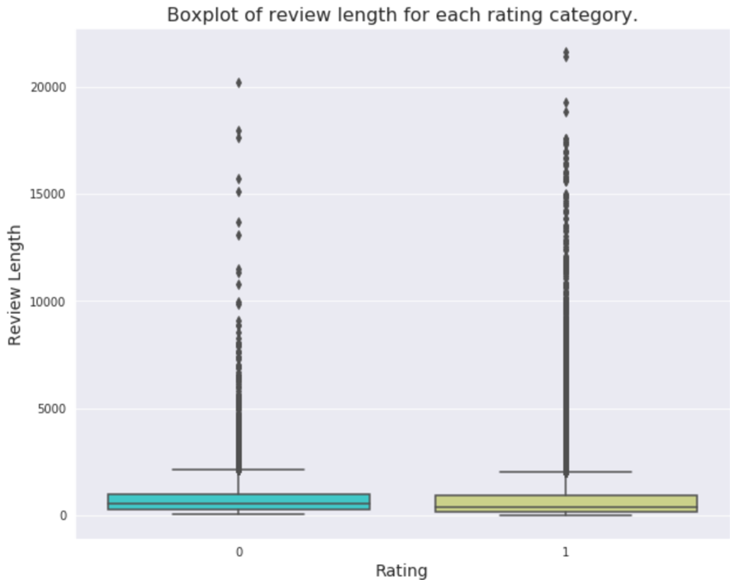
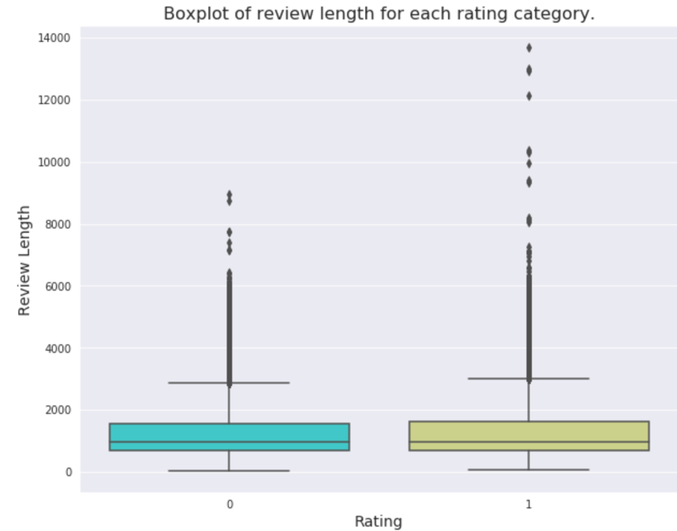
Data exploration: Review Length
Laptop dataset review lengths
Movie dataset review lengths
Notes:
The first dataset of laptop product reviews from Amazon’s website contained 40,744 reviews. The dataset contained over 30K positive reviews and close to 10K negative reviews. The longest positive review length contained over 20,000 characters and longest negative review contained close to 3,000 characters. The box plot of review length shows exponential properties. Looking at the graph shown in Fig 5 it can be estimated that the mass of the distribution can probably be covered with a clipped length of 900 to 1,000 words. The review dataset contains just two columns, one with the rating and the other with the review text.
The IMDb movie review dataset contains 50,000 reviews. The dataset contains equal number of reviews annotated as positive and negative. The longest positive review length contains about 14,000 characters and the longest negative review contains close to 5,000 characters. Similar to the first dataset, the box plot of review length shows exponential properties. Looking at the graph shown in Fig 6 it can be estimated that the mass of the distribution can probably be covered with a clipped length of 1,400 to 1,500 words. The review dataset contains just two columns, one with the rating and the other with the review text.

Slide 12
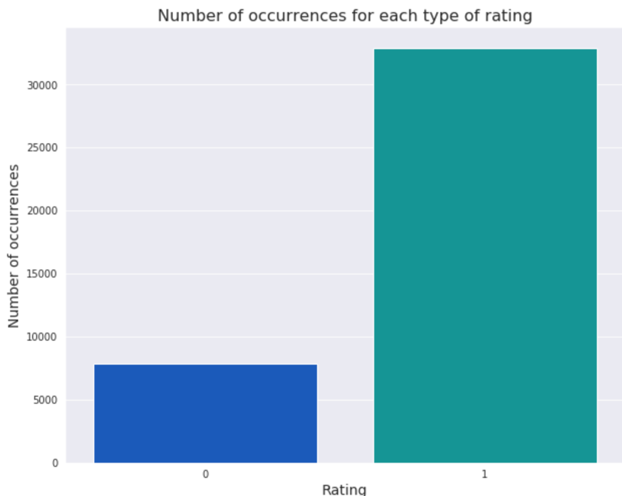
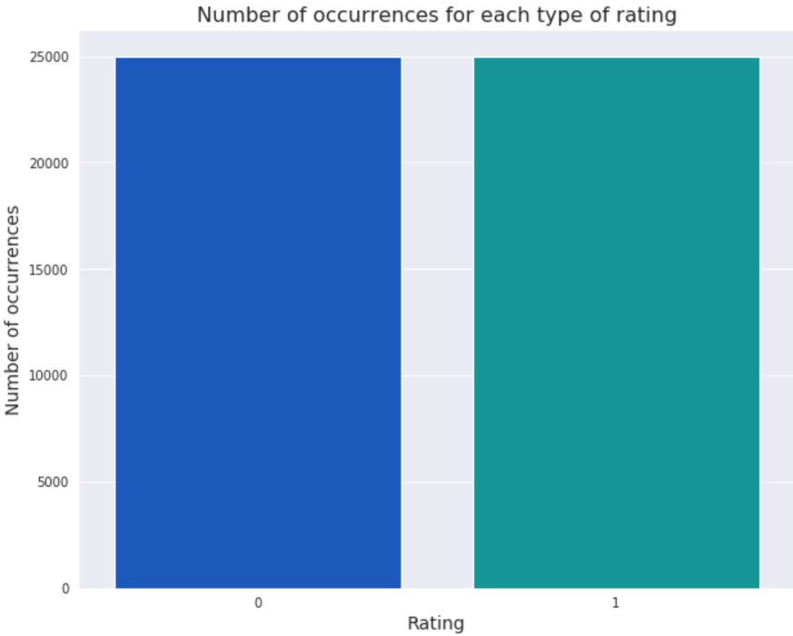
Data exploration: Review Count
Laptop dataset review count
Movie dataset review count
Notes:
The first dataset of laptop product reviews from Amazon’s website contained 40,744 reviews. The dataset contained over 30K positive reviews and close to 10K negative reviews. The longest positive review length contained over 20,000 characters and longest negative review contained close to 3,000 characters. The box plot of review length shows exponential properties. Looking at the graph shown in Fig 5 it can be estimated that the mass of the distribution can probably be covered with a clipped length of 900 to 1,000 words. The review dataset contains just two columns, one with the rating and the other with the review text.
The IMDb movie review dataset contains 50,000 reviews. The dataset contains equal number of reviews annotated as positive and negative. The longest positive review length contains about 14,000 characters and the longest negative review contains close to 5,000 characters. Similar to the first dataset, the box plot of review length shows exponential properties. Looking at the graph shown in Fig 6 it can be estimated that the mass of the distribution can probably be covered with a clipped length of 1,400 to 1,500 words. The review dataset contains just two columns, one with the rating and the other with the review text.

Slide 13
Text pre-processing
Input
Review string
Remove
HTML tags, URLs
Convert
To lowercase
Split
Remove
Into words
Punctuations, Empty Strings, Stop-words
Return
Concatenated tokens as a sentence

Slide 14
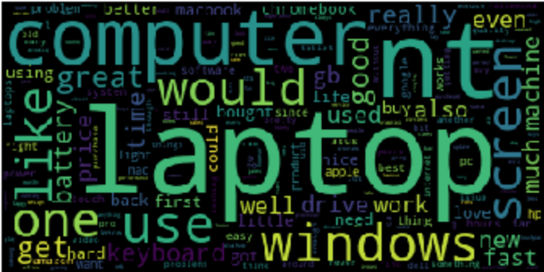
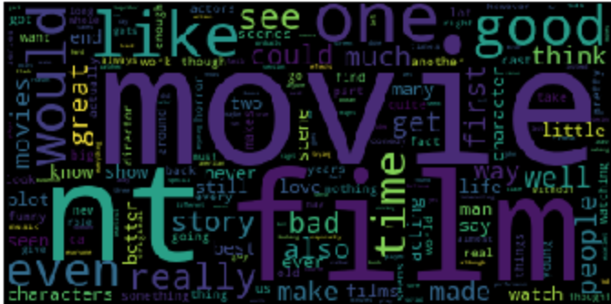
Exploring dataset
Looking at high frequency words in each dataset using nltk.FreqDist()
Notes:
The term frequency distribution of words in the review is obtained using nltk.FreqDist(). This provides us a rough idea of the main topic in the review dataset.

Slide 15
Word2Vec: Continuous Bag-Of-Words
Notes:
Word embedding is a language modeling technique that uses vectors with several dimensions to represent words from large amounts of unstructured text data. Word embeddings can be generated using various methods like neural networks, co-occurrence matrix, probabilistic models, etc. There are two models for generating word embeddings, i.e. CBOW and Skip-gram. CBOW (Continuous Bag of Words) model CBOW model predicts the current word given a context of words. The input layer contains context words and the output layer contains current predicted word. The hidden layer contains the number of dimensions in which to represent current word at output layer. The CBOW architecture is shown in Fig 1.

Slide 16
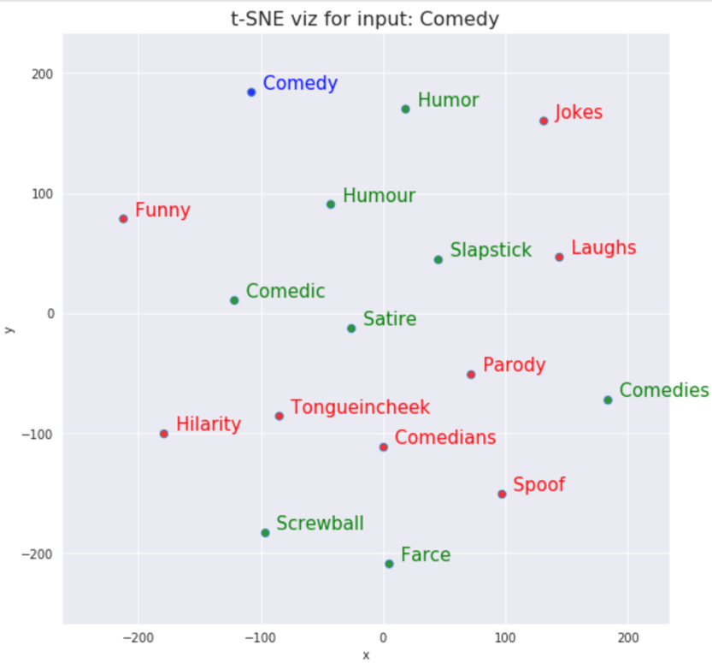
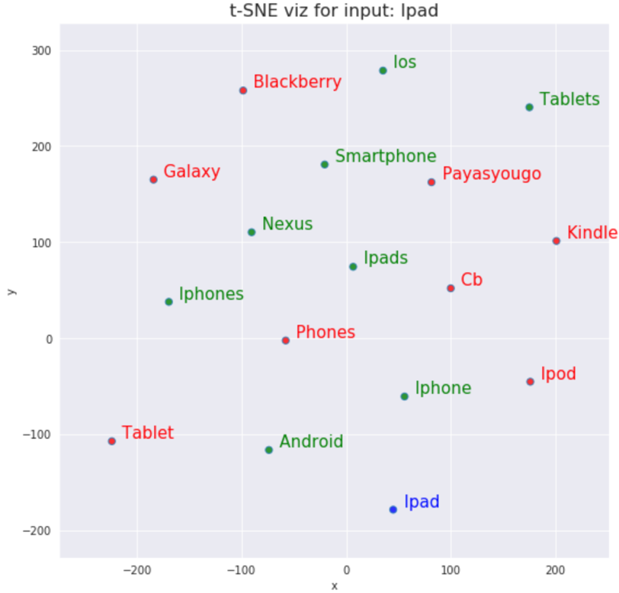
Word2Vec CBOW model evaluation
Notes:
The first dataset of laptop product reviews from Amazon’s website contained 40,744 reviews. The dataset contained over 30K positive reviews and close to 10K negative reviews. The longest positive review length contained over 20,000 characters and longest negative review contained close to 3,000 characters. The box plot of review length shows exponential properties. Looking at the graph shown in Fig 5 it can be estimated that the mass of the distribution can probably be covered with a clipped length of 900 to 1,000 words. The review dataset contains just two columns, one with the rating and the other with the review text.
The IMDb movie review dataset contains 50,000 reviews. The dataset contains equal number of reviews annotated as positive and negative. The longest positive review length contains about 14,000 characters and the longest negative review contains close to 5,000 characters. Similar to the first dataset, the box plot of review length shows exponential properties. Looking at the graph shown in Fig 6 it can be estimated that the mass of the distribution can probably be covered with a clipped length of 1,400 to 1,500 words. The review dataset contains just two columns, one with the rating and the other with the review text.

Slide 17
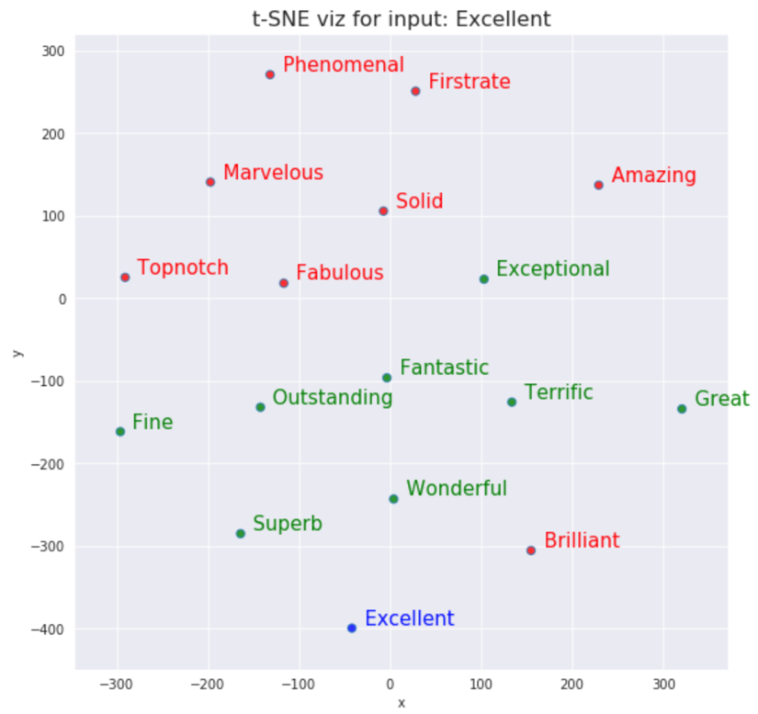
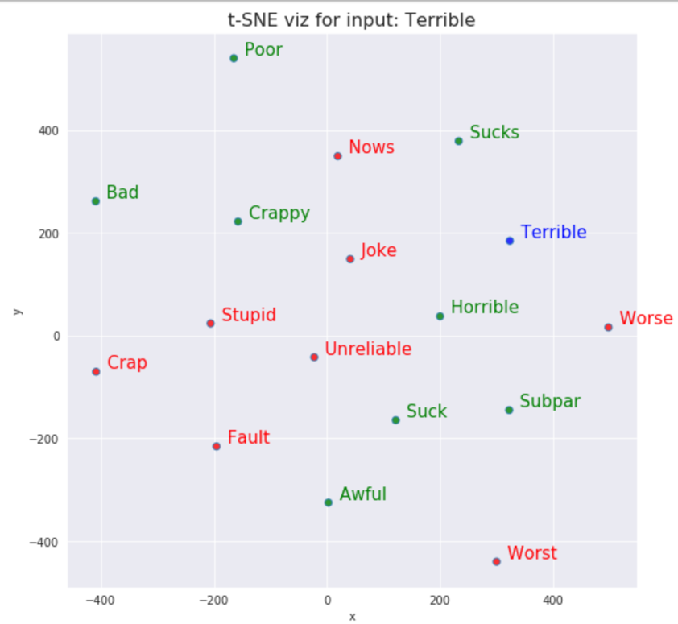
Word2Vec CBOW model evaluation
Notes:
The first dataset of laptop product reviews from Amazon’s website contained 40,744 reviews. The dataset contained over 30K positive reviews and close to 10K negative reviews. The longest positive review length contained over 20,000 characters and longest negative review contained close to 3,000 characters. The box plot of review length shows exponential properties. Looking at the graph shown in Fig 5 it can be estimated that the mass of the distribution can probably be covered with a clipped length of 900 to 1,000 words. The review dataset contains just two columns, one with the rating and the other with the review text.
The IMDb movie review dataset contains 50,000 reviews. The dataset contains equal number of reviews annotated as positive and negative. The longest positive review length contains about 14,000 characters and the longest negative review contains close to 5,000 characters. Similar to the first dataset, the box plot of review length shows exponential properties. Looking at the graph shown in Fig 6 it can be estimated that the mass of the distribution can probably be covered with a clipped length of 1,400 to 1,500 words. The review dataset contains just two columns, one with the rating and the other with the review text.

Slide 18
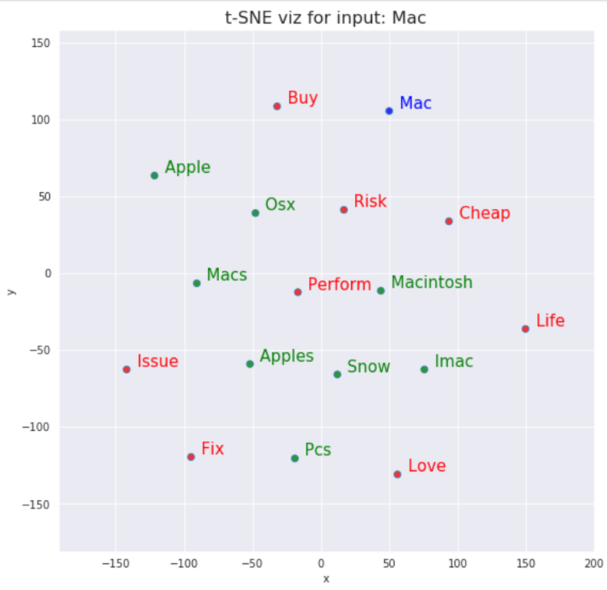
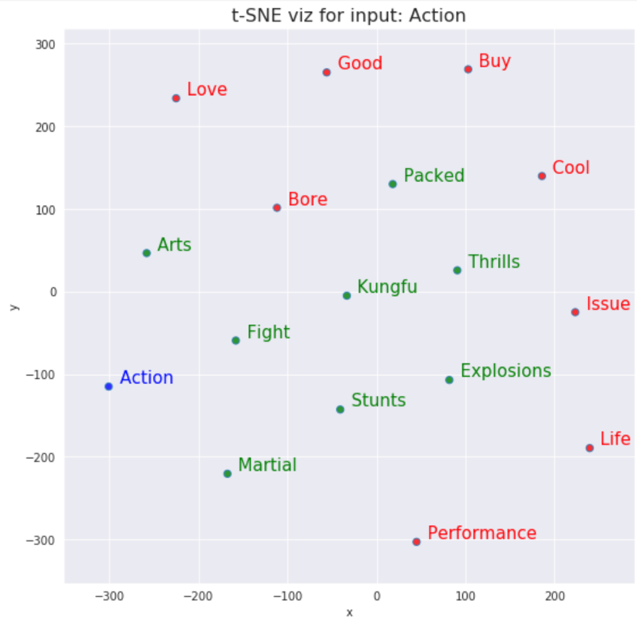
Word2Vec CBOW model evaluation
Notes:
The first dataset of laptop product reviews from Amazon’s website contained 40,744 reviews. The dataset contained over 30K positive reviews and close to 10K negative reviews. The longest positive review length contained over 20,000 characters and longest negative review contained close to 3,000 characters. The box plot of review length shows exponential properties. Looking at the graph shown in Fig 5 it can be estimated that the mass of the distribution can probably be covered with a clipped length of 900 to 1,000 words. The review dataset contains just two columns, one with the rating and the other with the review text.
The IMDb movie review dataset contains 50,000 reviews. The dataset contains equal number of reviews annotated as positive and negative. The longest positive review length contains about 14,000 characters and the longest negative review contains close to 5,000 characters. Similar to the first dataset, the box plot of review length shows exponential properties. Looking at the graph shown in Fig 6 it can be estimated that the mass of the distribution can probably be covered with a clipped length of 1,400 to 1,500 words. The review dataset contains just two columns, one with the rating and the other with the review text.

Slide 19
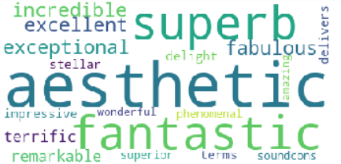
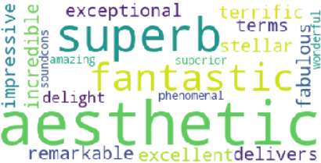
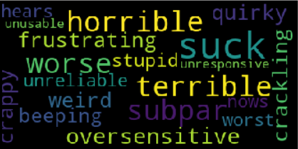
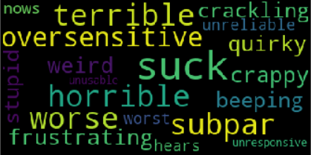
Positive and Negative review WORD clouds
Amazon dataset
IMDb movie review dataset
Positive cloud is with white background and negative cloud is with black background

Slide 20
Sentiment Analysis
Word2Vec Word Embedding Based Sentiment Analysis using LogisticRegression
Word2Vec Word Embedding Based Sentiment Analysis using SVC
Word2Vec Word Embedding Based Sentiment Analysis using XGBClassifier

Slide 21
Keras Convolutional Neural Network
Sentiment Analysis using Keras Convolutional Neural Networks(CNN)
Sentiment Analysis Using Pre-trained Word2Vec Word Embedding To Keras CNN
Image credit
Notes:
CNN is a class of deep, feed-forward artificial neural networks ( where connections between nodes do not form a cycle) & use a variation of multilayer perceptrons designed to require minimal preprocessing. These are inspired by animal visual cortex.
I have taken reference from Yoon Kim paper and this blog by Denny Britz.
CNNs are generally used in computer vision, however they’ve recently been applied to various NLP tasks and the results were promising 🙌 .

Slide 22
Bidirectional Long short Term Memory
Sentiment Analysis Using Pre-trained Word2Vec Word Embedding To Keras CNN And Bidirectional LSTM
Sentiment Analysis Using Pre-trained Word2Vec Word Embedding To Keras Bidirectional LSTM
Image credit
Notes:
Recurrent Neural Network (RNN) is one of the most popular architectures used in Natural Language Processing (NLP) tasks because its recurrent structure is very suitable to process variable length text. RNN can utilize distributed representations of words by first converting the tokens comprising each text into vectors, which form a matrix. And this matrix includes two dimensions: the time-step dimension and the feature vector dimension. Then most existing models usually utilize one-dimensional (1D) max pooling operation or attention-based operation only on the time-step dimension to obtain a fixed-length vector. However, the features on the feature vector dimension are not mutually independent, and simply applying 1D pooling operation over the time-step dimension independently may destroy the structure of the feature representation. On the other hand, applying two-dimensional (2D) pooling operation over the two dimensions may sample more meaningful features for sequence modeling tasks. Compared with the state-of-the-art models, the proposed models achieve excellent performance on 4 out of 6 tasks. Specifically, one of the proposed models achieves highest accuracy on Stanford Sentiment Treebank binary classification and fine-grained classification tasks.

Slide 23
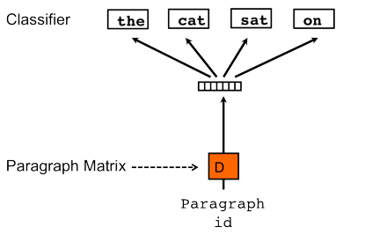
Doc2Vec: Distributed Bag-Of-Words
Doc2Vec DBOW Based Sentiment Analysis using LogisticRegression
Doc2Vec DBOW Based Sentiment Analysis using SVC
Doc2Vec DBOW Based Sentiment Analysis using XGBClassifier
Notes:
Doc2Vec can be modeled using paragraph vector distributed bag of words (PV-DBOW or DBOW model) which is a model analogous to Skip-gram in Word2Vec. The document vectors are obtained by training a neural network on the task of predicting a probability distribution of words in a paragraph given a randomly-sampled word from the document.

Slide 24
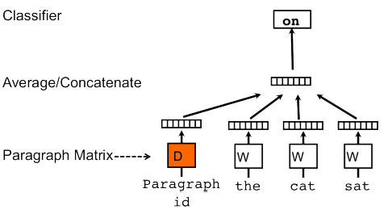
Doc2Vec: Distributed Memory
DM (Concatenated)
Doc2Vec DMC Based Sentiment Analysis using LogisticRegression
Doc2Vec DMC Based Sentiment Analysis using SVC
Doc2Vec DMC Based Sentiment Analysis using XGBClassifier
DM (Mean)
Doc2Vec DMM Based Sentiment Analysis using LogisticRegression
Doc2Vec DMM Based Sentiment Analysis using SVC
Doc2Vec DMM Based Sentiment Analysis using XGBClassifier
Notes:
Often called paragraph vector distributed memory (PV-DM or DM model) is obtained by training a neural network on the task of inferring a center word based on context words and a context paragraph.

Slide 25
Doc2Vec: DBOW + DMC and DBOW + DMM
DBOW + DMC
Doc2Vec DBOW + DMC Based Sentiment Analysis using LogisticRegression
Doc2Vec DBOW + DMC Based Sentiment Analysis using SVC
Doc2Vec DBOW + DMC Based Sentiment Analysis using XGBClassifier
Doc2Vec DBOW + DMC Based Sentiment Analysis using Keras Neural Network
DBOW + DMM
Doc2Vec DBOW + DMM Based Sentiment Analysis using LogisticRegression
Doc2Vec DBOW + DMM Based Sentiment Analysis using SVC
Doc2Vec DBOW + DMM Based Sentiment Analysis using XGBClassifier
Doc2Vec DBOW + DMC Based Sentiment Analysis using Keras Neural Network
Notes:
Often called paragraph vector distributed memory (PV-DM or DM model) is obtained by training a neural network on the task of inferring a center word based on context words and a context paragraph.

Slide 26
Results: Word2Vec
Model |  | IMDB Movie Reviews Accuracy |  |  | Amazon Laptop Reviews Accuracy
 |  | Train | Validation | Test | Train | Validation | Test
Word2Vec | LogisticRegression | .8753 | .8692 | .8706 | .9046 | .9060 | .9009
 | SVC with linear kernel | .8755 | .8714 | .8690 | .9050 | .9089 | .9001
 | XGBClassifier | .8695 | .8540 | .8506 | .9058 | .9057 | .8967
Keras Convolutional Neural Networks (CNN) |  | .9994 | .8770 | .8788 | .9992 | .9239 | .9146
Using Pre-trained Word2Vec Word Embedding to Keras CNN |  | .9593 | .8444 | .8268 | .9690 | .8969 | .8891
Using Pre-trained Word2Vec Word Embedding to Keras CNN And Bidirectional LSTM |  | .9356 | .8854 | .8902 | .9567 | .9212 | .9144
Using Pre-trained Word2Vec Word Embedding to Keras Bidirectional LSTM |  | .9011 | .8800 | .8786 | .9418 | .9205 | .9229

Slide 27
Results: Doc2Vec Simple models
Model |  | IMDB Movie Reviews Accuracy |  |  | Amazon Laptop Reviews Accuracy
 |  | Train | Validation | Test | Train | Validation | Test
Doc2Vec DBOW | LogisticRegression | .8732 | .8738 | .8778 | .8982 | .9094 | .8955
 | SVC with linear kernel | .8738 | .8742 | .8766 | .8985 | .9072 | .8969
 | XGBClassifier | .8682 | .8500 | .8556 | .9008 | .8964 | .8849
Doc2Vec DMC | LogisticRegression | .5939 | .5862 | .5986 | .8088 | .8137 | .7961
 | SVC with linear kernel | .5933 | .5864 | .5936 | .8086 | .8130 | .7956
 | XGBClassifier | .6214 | .5952 | .5958 | .8137 | .8193 | .7980
Doc2Vec DMM | LogisticRegression | .8187 | .8196 | .8174 | .8472 | .8571 | .8307
 | SVC with linear kernel | .8193 | .8184 | .8190 | .8428 | .8554 | .8280
 | XGBClassifier | .8115 | .7858 | .7920 | .8494 | .8525 | .8282

Slide 28
Results: Doc2Vec Model combos
Model |  | IMDB Movie Reviews Accuracy |  |  | Amazon Laptop Reviews Accuracy
 |  | Train | Validation | Test | Train | Validation | Test
DBOW + DMC | LogisticRegression | .8741 | .8738 | .8778 | .8982 | .9099 | .8940
 | SVC with linear kernel | .8751 | .8744 | .8790 | .8990 | .9072 | .8977
 | XGBClassifier | .8692 | .8510 | .8574 | .9000 | .8969 | .8849
DBOW + DMM | LogisticRegression | .8813 | .8742 | .8804 | .9024 | .9092 | .8994
 | SVC with linear kernel | .8809 | .8756 | .8786 | .9033 | .9092 | .9001
 | XGBClassifier | .8736 | .8548 | .8590 | .9016 | .8986 | .8854
Combination of Doc2Vec DBOW And DMC Document Embedding and Keras Neural Network |  | .9088 | .8742 | .8746 | .9312 | .9040 | .9033
Combination of Doc2Vec DBOW And DMM Document Embedding and Keras Neural Network |  | .9295 | .8722 | .8720 | .9475 | .9156 | .8984

Slide 29
Confusion Matrix: Word2Vec
Model |  | IMDB Movie Reviews Confusion Matrix with Accuracy |  |  |  |  | Amazon Laptop Reviews Confusion Matrix with Accuracy
 |  | TN | FP | FN | TP | Accuracy | TN | FP | FN | TP | Accuracy
Word2Vec | LR | 2185 | 344 | 303 | 2168 | 0.87 | 554 | 279 | 125 | 3117 | 0.90
 | SVC | 2182 | 347 | 308 | 2163 | 0.87 | 557 | 276 | 131 | 3111 | 0.90
 | XGBClassifier | 2127 | 402 | 345 | 2126 | 0.85 | 535 | 298 | 123 | 3119 | 0.90
Keras Convolutional Neural Networks(CNN) |  | 2302 | 227 | 379 | 2092 | 0.88 | 591 | 242 | 106 | 3136 | 0.91
Pre-trained Word2Vec Word Embedding To Keras CNN |  | 2110 | 419 | 447 | 2024 | 0.83 | 571 | 262 | 190 | 3052 | 0.89
Pre-trained Word2Vec Word Embedding To Keras CNN And Bidirectional LSTM |  | 2208 | 321 | 228 | 2243 | 0.89 | 615 | 218 | 131 | 3111 | 0.91
Pre-trained Word2Vec Word Embedding To Keras Bidirectional LSTM |  | 2176 | 353 | 254 | 2217 | 0.88 | 652 | 181 | 133 | 3109 | 0.92

Slide 30
Confusion Matrix: DOC2Vec Simple Models
Model |  | IMDB Movie Reviews Confusion Matrix with Accuracy |  |  |  |  | Amazon Laptop Reviews Confusion Matrix with Accuracy
 |  | TN | FP | FN | TP | Accuracy | TN | FP | FN | TP | Accuracy
DBOW | LogisticRegression | 2205 | 324 | 287 | 2184 | 0.88 | 530 | 303 | 123 | 3119 | 0.90
 | SVC | 2204 | 325 | 292 | 2179 | 0.88 | 533 | 300 | 120 | 3122 | 0.90
 | XGBClassifier | 2152 | 377 | 345 | 2126 | 0.86 | 467 | 366 | 103 | 3139 | 0.88
DMC | LogisticRegression | 1586 | 943 | 1064 | 1407 | 0.60 | 2 | 831 | 0 | 3242 | 0.80
 | SVC | 1654 | 875 | 1157 | 1314 | 0.59 | 0 | 833 | 0 | 3242 | 0.80
 | XGBClassifier | 1452 | 1077 | 944 | 1527 | 0.60 | 28 | 805 | 18 | 3224 | 0.80
DMM | LogisticRegression | 2064 | 465 | 448 | 2023 | 0.82 | 246 | 587 | 103 | 3139 | 0.83
 | SVC | 2062 | 467 | 438 | 2033 | 0.82 | 201 | 632 | 69 | 3173 | 0.83
 | XGBClassifier | 1981 | 548 | 492 | 1979 | 0.79 | 193 | 640 | 60 | 3182 | 0.83

Slide 31
Confusion Matrix: doc2Vec Model Combos
Model |  | IMDB Movie Reviews Confusion Matrix with Accuracy |  |  |  |  | Amazon Laptop Reviews Confusion Matrix with Accuracy
 |  | TN | FP | FN | TP | Accuracy | TN | FP | FN | TP | Accuracy
DBOW + DMC | LR | 2204 | 325 | 286 | 2185 | 0.88 | 524 | 309 | 123 | 3119 | 0.89
 | SVC | 2210 | 319 | 286 | 2185 | 0.88 | 529 | 304 | 113 | 3129 | 0.90
 | XGBClassifier | 2164 | 365 | 348 | 2123 | 0.86 | 472 | 361 | 108 | 3134 | 0.88
DBOW + DMM | LR | 2206 | 323 | 275 | 2196 | 0.88 | 538 | 295 | 115 | 3127 | 0.90
 | SVC | 2209 | 320 | 287 | 2184 | 0.88 | 538 | 295 | 112 | 3130 | 0.90
 | XGBClassifier | 2166 | 363 | 342 | 2129 | 0.86 | 465 | 368 | 99 | 3143 | 0.89
DBOW + DMC And Keras Neural Network |  | 2187 | 342 | 285 | 2186 | 0.87 | 564 | 269 | 125 | 3117 | 0.90
DBOW + DMM And Keras Neural Network |  | 2142 | 387 | 253 | 2218 | 0.87 | 572 | 261 | 153 | 3089 | 0.90

Slide 32
Conclusion
Keras Bidirectional LSTM and Keras CNN + Bidirectional LSTM
Word2Vec
LogisticRegression > SVC > XGBClassifier
Keras CNN
Keras CNN
With Tokenizer
with Pre-trained Word2Vec Word Embedding
Word2Vec > Doc2Vec
with Pre-trained Word2Vec Word Embedding
DBOW > DMM > DMC and DOW + DMC > DMC Also DOW + DMM > DMM
DBOW + DMM > DBOW + DMC

Slide 33
Conclusion
Bidirectional LSTM is a Recurrent Neural Network (RNN). RNNs have the advantage of being able to persist information. The network considers current inputs as well as, previously received inputs. Hence, it works really well with sequence data like text, time series, videos, DNA sequences, etc

